Slide 1
From Volume Growth to Value-Driven Customer Strategy
Business Context:
Equinox has experienced rapid platform growth, but leadership suspects uneven customer quality beneath stable revenue performance.
Structural Challenges:
High cart abandonment despite strong traffic
Certain segments driving disproportionate return losses
Premium subscription growth below expectations
Revenue stability masking uneven customer value
Objectives:
Evaluate long-term importance of each customer
Identify stable revenue drivers vs growth opportunities
Allocate customers across strategic teams (CORE & APEX)
Deploy ₹1 Cr investment to improve portfolio quality
Customer Data
Team Allocation
Targeted Investment & Portfolio improvement
Strategic Value Framework

Slide 2
Customer Strategic Value Framework
Economic Strength (35%)
Engagement Depth (25%)
Stability (20%)
Growth Potential (20%)
Measures current revenue distribution
Measures platform Interaction Intensity
Captures operational reliability of customers
Measures future monetisation opportunities
Component | Key Variables
Economic | Monthly Spend (50%), AOV (30%), Conversion Rate (20%)
Engagement | Session Time (25%), App Usage (25%), Browse-to-Buy (25%), Cart Items (25%)
Stability | Return Rate (40%), Cart Abandonment (30%), Checkout Abandonment (30%)
Growth | Brand Loyalty (40%), Premium Adoption (20%), Impulse Purchases (20%), Loyalty Program (20%)
Monthly spend winsorized at the 99th percentile to control extreme outliers
All variables normalized using min-max scaling

Slide 3
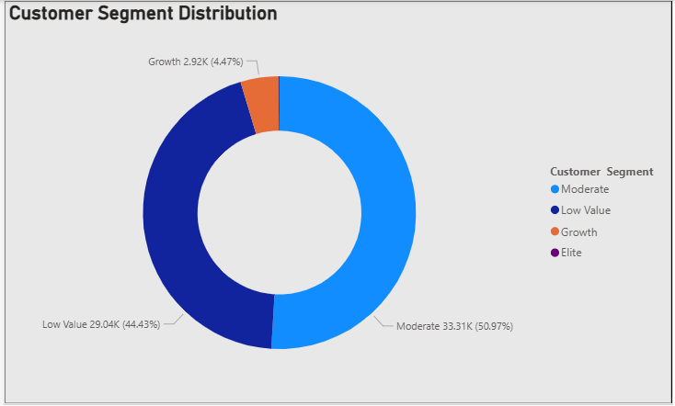
Customer Segmentation & Strategic Portfolio Insights
Portfolio Composition: Most customers belong to Moderate and Low Value segments, indicating a volume-driven customer base rather than value-driven growth.
Revenue Concentration: Elite customers generate disproportionate revenue, spending ₹12.6K on average — nearly 5× the Growth segment.
Risk in High-Value Segment: Elite customers show the highest return rate (0.63), indicating a trade-off between revenue and operational cost risk.
Growth Opportunity: Growth customers demonstrate the highest premium adoption (0.67), making them ideal targets for monetization initiatives.
Segment | Characteristics | Strategic Insight
Elite | Highest spend, strong engagement, strong conversion | Revenue drivers but high return risk
Growth | High engagement, strong conversion, highest premium adoption | High-potential segment for monetization
Moderate | Medium engagement, low spending | Stable but low revenue impact
Low Value | Low spend, high abandonment | Traffic heavy but economically weak
The platform must protect high-value Elite customers while strategically investing in Growth customers to expand premium adoption and long-term revenue potential.

Slide 4
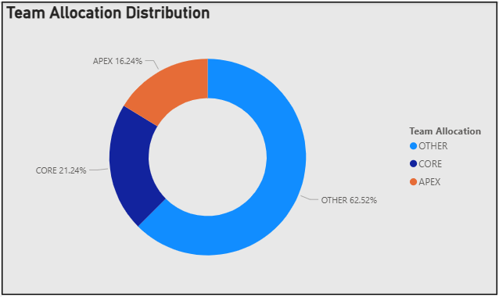
Strategic Customer Allocation: CORE vs APEX
Strategic Value Concentration: Only ~37% of customers fall into CORE or APEX, indicating that a small portion of the customer base drives most of the platform’s strategic value.
CORE Revenue Backbone: CORE customers spend ~2.3–2.4× more than other segments, demonstrating strong monetization, loyalty, and premium adoption.
APEX Growth Engine: APEX customers exhibit high engagement and growth signals but lower monetization, indicating untapped revenue potential.
Limited ROI from OTHER Segment: OTHER customers show low spending and weak engagement, suggesting limited return on investment.
Segment | Rules | Role | Strategy
CORE | Strategic Value ≥ 50 Stability Score ≥ 45 | Stable high-value customers | Retention & risk reduction
APEX | Engagement ≥ 35 Growth Score ≥ 35 | Growth potential customers | Monetization & premium expansion
OTHER | - | Low strategic priority | Minimal investment
By prioritizing CORE for stability and APEX for expansion, Equinox can transition from volume-driven growth to value-driven customer prioritization.

Slide 5
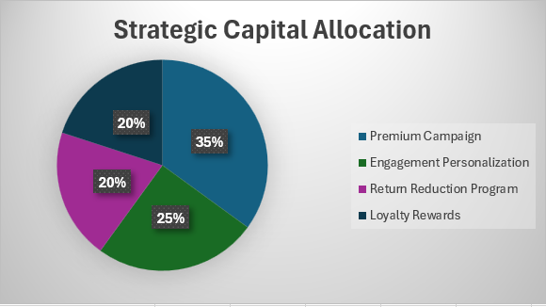
Strategic Capital Allocation to Improve Customer Portfolio Quality
Key Assumptions:
Premium adoption increases +8% through targeted incentives for high-engagement APEX customers
Conversion improves +5% through personalized recommendations and notifications
Return rate decreases −3% through better product recommendations and product information
Initiative | Target Segment | Budget | Expected Impact
Premium Campaign | APEX | ₹35L | +8% premium adoption
Engagement Personalization | APEX | ₹25L | +5% conversion
Return Reduction Program | CORE | ₹20L | −3% return rate
Loyalty Rewards | CORE | ₹20L | +4% engagement
Capital deployment prioritizes APEX-driven growth (60%) while safeguarding CORE stability (40%), creating a balanced customer portfolio strategy.
Targeted behavioral interventions improve overall Customer Strategic Value by ~13%.

Slide 6
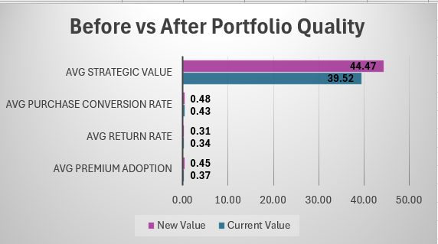
Portfolio Impact Simulation
Strategic Impact:
Premium Adoption Growth (37% → 45%):
Higher recurring subscription revenue
Increased customer loyalty and platform lock-in
Higher customer lifetime value (CLV)
Conversion Rate Improvement (43% → 48%):
More purchases from existing traffic
Higher revenue efficiency
Better monetization of engagement
Return Rate Reduction (34% → 31%):
Lower reverse logistics and refund costs
More stable revenue realization
Reduced operational volatility
Targeted behavioral interventions improve engagement, monetization, and operational stability — increasing overall Customer Strategic Value by ~13%.
This demonstrates that focused investment in high-impact customer segments can significantly enhance long-term platform profitability and portfolio quality.

Slide 7
Strategic Recommendations
Protect CORE Revenue Base
CORE customers generate the most stable and high-value revenue.
Strengthen loyalty and retention programs
Reduce return-related operational risks
Offer exclusive benefits to maintain engagement
Outcome: Stable and predictable revenue streams.
Improve Operational Efficiency
High return rates create unnecessary costs.
Improve product recommendations and information
Monitor return behavior in high-spend segments
Outcome: Lower operational costs and improved revenue stability.
Monetize APEX Growth Segment
APEX customers show strong engagement but are under-monetized.
Expand premium subscription campaigns
Use personalized recommendations to increase conversion
Encourage repeat purchases and larger baskets
Outcome: Higher long-term revenue growth.
By prioritizing CORE stability and APEX growth, Equinox shifts from volume-driven expansion to value-driven customer strategy, improving portfolio quality and sustainable profitability.

Slide 8
THANKYOU
Ruchi Rathore (IT 4th Year)
-Government Engineering College Ajmer

